Slide 1

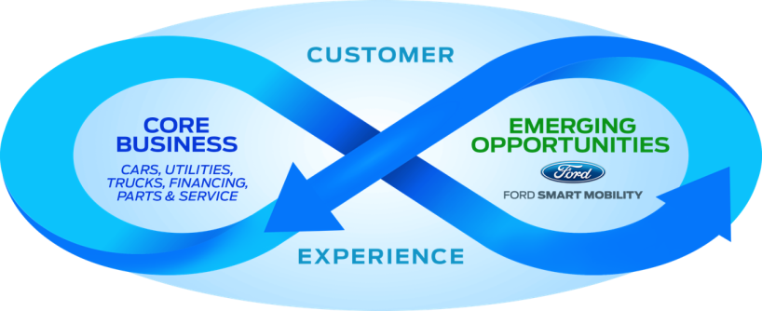

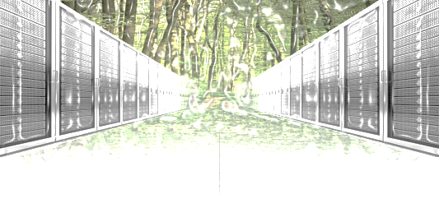
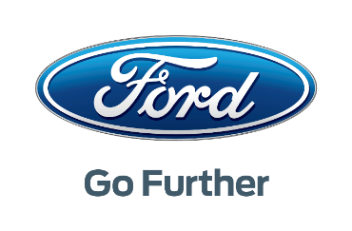
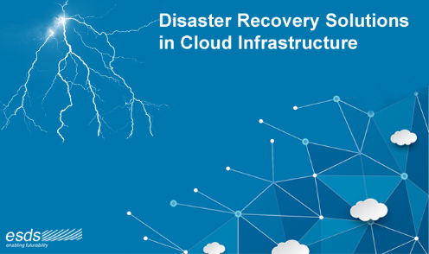
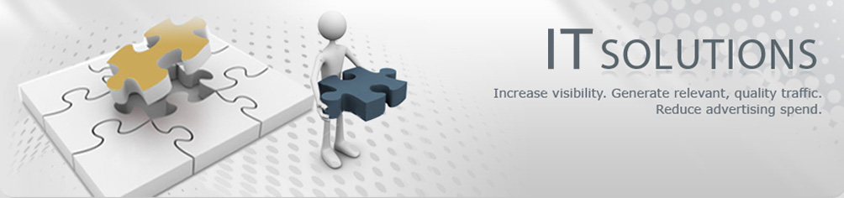
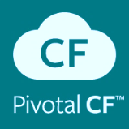
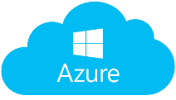
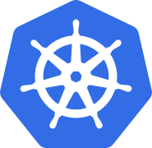

NG Program Management & Services Design
To engineer high-quality and innovative data center infrastructure to act as an integrated system rather than individual technology stacks that are operated independently.
NG Cloud Automation
One Team, One Plan, One Goal
Crunch Time
Kubernetes Up & Running : Why, What, How
NG Cloud Engineering
NG Solutions Engineering

Slide 2
NGDC Objectives
Decouple Worlds
Eliminate Toil
Improve Efficiency
Resource Isolation
Resource Utilization
Workload Scalability
High Availability
Security
Portability
Notes:
Decouple Worlds:
development and operations environments are decoupled from your physical hosting environment. Move from on-premises to the cloud, between public clouds, update your operating systems and underlying infrastructure with minimal impact to your apps. Create application container images at build/release time rather than deployment time, thereby decoupling applications from infrastructure.
Eliminate Toil:
Move from ticket driven operations to API driven operations. Let developers focus on the code that runs the business, and build operations team to support your business. Achieve unprecedented levels of automation.
Improve Efficiency:
Dynamically scheduled container packaged systems are radically more efficient than traditional VM based technologies. Early users report up to 75% savings in infrastructure bill by transition to Containers.
Resource Isolation:
Predictable application performance, eliminates noisy neighbor problem.
Resource Utilization:
High efficiency and density, building dedicated VM’s for each workload creates static portions and lead low overall resource utilization across data center. Whereas exposing the entire data center as a one shared virtual compute infrastructure with resource isolation and quotas dramatically improves utilization and savings in $$.
Workload Scalability:
Applications deployed in container cluster are packaged as containers. These applications are composed of multiple containers grouped as pods. Each container is designed to perform only one task. Pods can be composed of stateless containers or stateful containers. Pods can easily be scaled on-demand or through dynamic auto-scaling. Kubernetes supports horizontal pod auto-scaling which, scales the number of pods in a replication controller based on CPU auto-scale rules and thresholds. Future version will support custom metrics for defining the auto-scale rules and thresholds.
Container cluster orchestration systems also support persistent workloads, such as NoSQL databases and relational database management systems (RDBMS), through stateful sets; this enables scaling stateless applications such as Cassandra clusters and MongoDB replica sets. This capability will bring elastic, stateless web tiers and persistent, stateful databases together to run on the same infrastructure.
High Availability:
Contemporary workloads demand availability at both the infrastructure and application levels. In clusters at scale, everything is prone to failure, which makes high availability for production workloads strictly necessary. While most container orchestration engines and PaaS offerings deliver application availability, Kubernetes is designed to tackle availability of both infrastructure and applications.
On the application front, Kubernetes ensures high availability by means of replica sets, replication controllers and stateful sets. Operators can declare the minimum number of pods that need to run at any given point of time. If a container or pod crashes due to an error, the declarative policy can bring the deployment to the desired configuration.
For infrastructure availability, Kubernetes has support for a wide range of storage backend, ranging from distributed file systems such as Network file system (NFS), Ceph, and GlusterFS, Block devices such Azure Persistent Disk, VMware VSAN, Amazon EBS, and specialized container storage plugins such as Flocker. Adding a reliable, available storage layer to Kubernetes ensure high availability of stateful workloads.
Security:
Reducing the attack surface is a basic tenet of security. Preventing code with vulnerabilities from entering into the environment is a perfect example of reducing a key attack surface, containers are designed to host just the applications and its dependent libraries they provide a reduce attack surface. But containerization has specific structural and operational elements that require special attention, mainly the underlying shared kernel architecture of containers requires attention beyond securing the host. But these concerns can be addressed using Isolation features built into Linux kernel (namespaces, capabilities) and other security features offered by Linux kernel namely SELinux, AppArmor.
Kubernetes provides additional security network boundaries using “network policy” which either allows or restricts network traffic to pods, based specification provided by the application team. This is useful to obscure pods in a multi-tier deployment that shouldn’t be exposed to other applications.
Portability:
Containers are deigned to offer freedom of choice when choosing operating systems, container runtimes, process architectures, cloud platforms. Container orchestration systems also provide native federation which allows to mix and match container clusters running across multiple cloud providers and on-premises. This bring hybrid cloud capabilities to containerized workloads. It also provides an opportunity lift and carry some legacy applications there by reducing and/or possibly eliminating a need to build and operate purpose built infrastructure.
Summary:
The Old Way to deploy applications was to install the applications on a host using the operating system package manager. This had the disadvantage of entangling the applications’ executables, configuration, libraries, and lifecycles with each other and with the host OS. One could build immutable virtual-machine images in order to achieve predictable rollouts and rollbacks, but VMs are heavyweight and non-portable.
The New Way is to deploy containers based on operating-system-level virtualization rather than hardware virtualization. These containers are isolated from each other and from the host: they have their own filesystems, they can’t see each others’ processes, and their computational resource usage can be bounded. They are easier to build than VMs, and because they are decoupled from the underlying infrastructure and from the host filesystem, they are portable across clouds and OS distributions.
Because containers are small and fast, one application can be packed in each container image. This one-to-one application-to-image relationship unlocks the full benefits of containers. With containers, immutable container images can be created at build/release time rather than deployment time, since each application doesn’t need to be composed with the rest of the application stack, nor married to the production infrastructure environment. Generating container images at build/release time enables a consistent environment to be carried from development into production. Similarly, containers are vastly more transparent than VMs, which facilitates monitoring and management. This is especially true when the containers’ process lifecycles are managed by the infrastructure rather than hidden by a process supervisor inside the container. Finally, with a single application per container, managing the containers becomes tantamount to managing deployment of the application.
https://kubernetes.io/docs/concepts/overview/what-is-kubernetes/

Slide 3
Traditional Hosting
Application and OS share file system
Use OS distribution package manager
Entangled with each other and with host
Executables
Configuration
Shared libraries
Process and lifecycle management
Mutable VM images provide unpredictable rollouts and rollbacks. Heavyweight and not portable.
Guest Environment
APP1
APP2
APP3
Libraries
Guest OS/Kernel
Hypervisor
Hardware

Slide 4
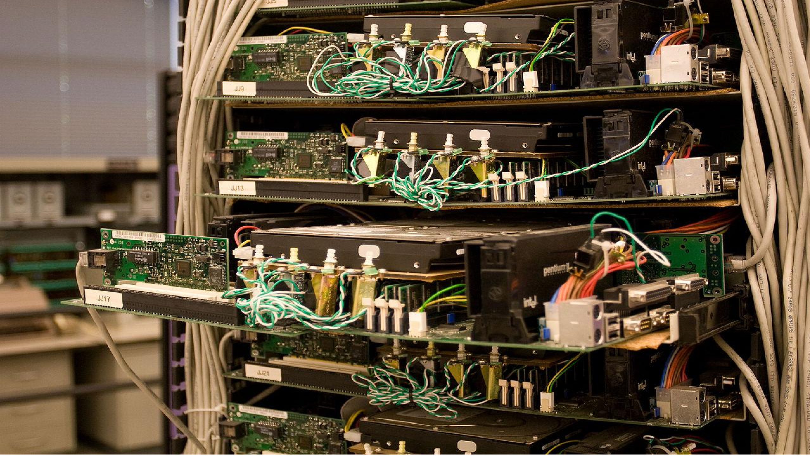
“How to keep my operating system updated without causing application downtime?”

Slide 5
“How to update/rollback applications without causing downtime?”

Slide 6
“How to provide HA/DR without incurring associated complexity?”

Slide 7
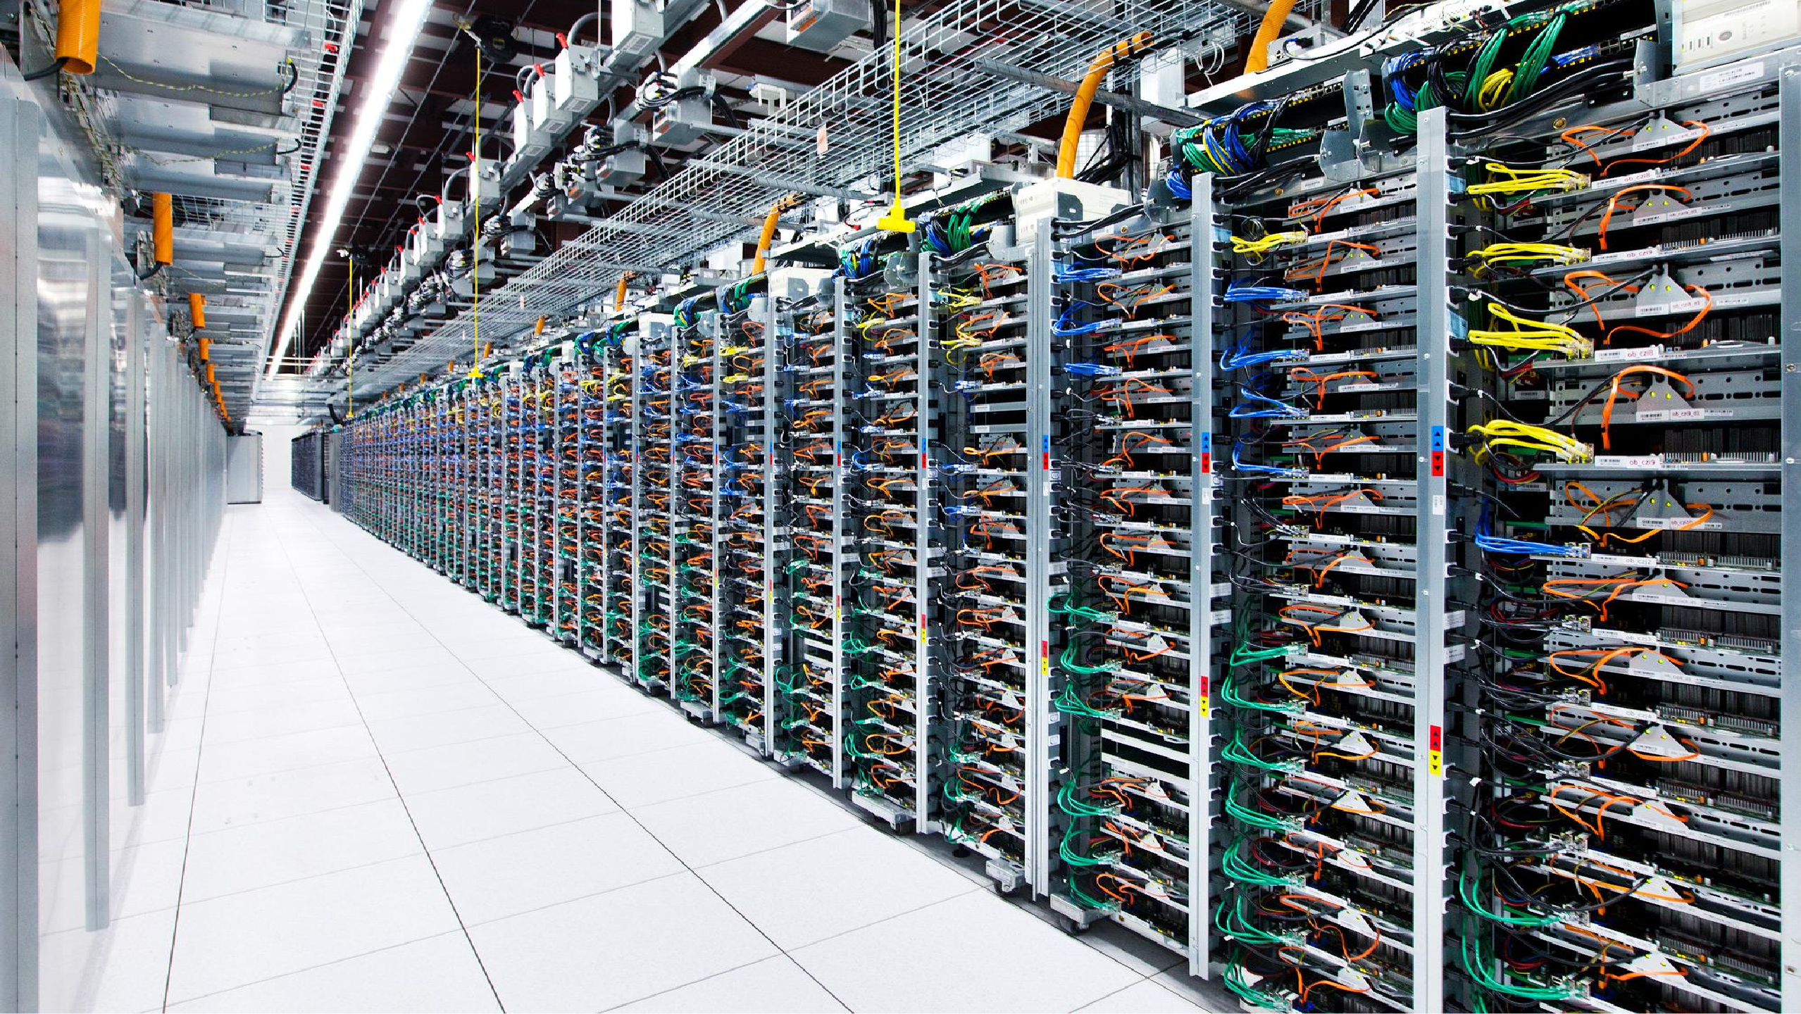
“How do I make sure my compute jobs can’t hurt my database job?”

Slide 8
“How do I safely pack more work onto less machines?”

Slide 9
Isolation vs Utilization
We need to isolate the applications
Guest Environment
Guest Environment
Guest Environment
Application 1
Application 2
Application 3
Libraries
Libraries
Libraries
Guest OS/Kernel
Guest OS/Kernel
Guest OS/Kernel
Redundant
Hypervisor
Hypervisor
Hypervisor
Hardware
Hardware
Hardware
Notes:
We need a way to represent workloads to be deployed on nodes. We could wrap each application component in its own virtual machine and then compose these machines through network ports, shared disks etc. However, there is a large overhead with this approach e.g. three separate copies of Ubuntu 14.04 in the example below. These large images are slow are slow to deploy.

Slide 10
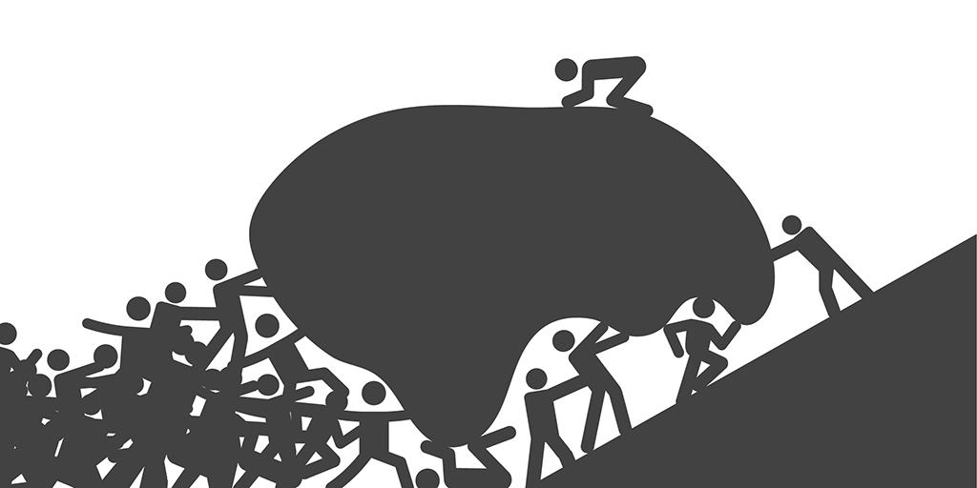

Slide 11


Slide 12


Slide 13
A Challenge
Have you ever had “/” vs “\” break your app? Or perhaps needed a unique version of a JDBC driver? Or had a datasource with a slightly misspelled JNDI name? Or received a patch for the JVM or app server that broke your code?
.war or .ear
Custom Configuration
JDBC driver, datasource, JMS queue, users
Application Server
Weblogic 10.x.y, Tomcat 6.x.y, WAS 8.x.y
Java Virtual Machine
Java 1.6.6_45 or Java 1.7.0_67
Operating System
Linux Kernel Version & Distribution
Server Hardware

Slide 14
Email
MyApp.war has been tested with the following
On my Windows 7/10 desktop
JDK 1.8.43
WAS Local Server 9
Configuration:
Datasource: H2
Tested with: h2-5.1.31-bin.jar
Production Environment
SuSe Linux 12.2
JRE 1.7.3
WebSphere 8.5.5
Oracle 9

Slide 15
Isolation & Utilization
“build once, run anywhere”
OS-level virtualization
Isolated, from each other and from the host
filesystems
processes
resources
Portable across OS distros and clouds
Small and fast ⇒ enables 1:1 app to image
Unlocks benefits of CI/CD
Create immutable image at build time rather than deployment time configuration
Consistent environment from development to production
Facilitates application monitoring and management
Guest Environment
APP 1
APP 2
APP 3
Libraries
Libraries
Libraries
Guest OS/Kernel
Hypervisor
Hardware
Notes:
Docker takes care of the difference between the guest operating system that the container was written for and the actual host operating system. It provides a high-level API for managing (in our case) lightweight containers based on cgroups and namespaces. Since this is not full virtualization the application is still coupled to some degree to its host e.g. all the containers run with the host’s OS kernel.
Each application component can be bundled together with its own dependencies and shrink-wrapped for deployment. This avoids issues with missing dependencies from the environment (e.g. DLL hell). Containers aim to provide a mechanism for building an application component once and then deploying anywhere, but with a lot of caveats. “build once, run anywhere”... where have we heard that before :-)

Slide 16
Containers v/s VMs
Traditional Virtualization
Containers
APP1
APP2
APP 1
APP 2
APP 3
Libraries
Libraries
Libraries
Libraries
Libraries
Guest OS/Kernel
Guest OS/Kernel
Guest OS/Kernel
Hypervisor
Hypervisor
Hardware
Hardware

Slide 17
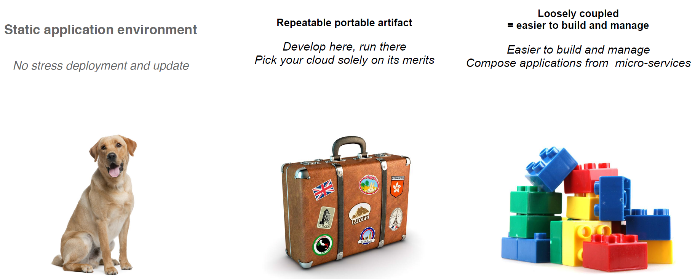
What’s is a Containers

Slide 18
How : Container Linux
Container
Linux
Traditional OS
Your Container Image
kernel
systemd
sshd
docker
rkt
Python
Java
nginx
MySQL
OpenSSL
Application 1
kernel
systemd
sshd
docker
rkt
Python
Application 1
Application 2
Java
Application 2
Application 3
nginx
Application 3
Required Software

Slide 19
Linux Kernel: Resource isolation
Implemented by a number of Linux APIs:
cgroups: Restrict resources a process can consume
CPU, memory, disk IO, ...
namespaces: Change a process’s view of the system
Network interfaces, PIDs, users, mounts, ...
capabilities: Limits what a user can do
mount, kill, chown, ...
chroots: Determines what parts of the filesystem a user can see

Slide 20
Dockerfile, Docker Image & Container
FROM ubuntu:16.04
RUN curl http://download.oracle.com/jdk-8u131-linux-x64.tar.gz
RUN tar –zxvf jdk-8u131-linux-x64.tar.gz
RUN curl http://mirrors.jenkins.io/war-stable/latest/jenkins.war
COPY plugin.sh /jenkins/
EXPOSE 8080
ENTRYPOINT ["/bin/tini", "--", "/usr/local/bin/jenkins.sh"]
THIN CONTAINER LAYER (RW)
ENTRYPOINT [“/bin/tini”, …..]
EXPOSE 8080
23d768bs.......
COPY plugin.sh /jenkins/
34dstrsc .......
RUN curl jenkins-2.4.62
CONTAINER
876ghtrsc .......
RUN curl oracle-jdk-8.131.11.tgz
56fhrxce43 .......
READ ONLY IMAGE LATERS
FROM UBUNTU:16.04
45tgvb467 .......
91e54dfgc .......
Notes:
Each Docker image references a list of read-only layers that represent filesystem differences. Layers are stacked on top of each other to form a base for a container’s root filesystem.
The Docker storage driver is responsible for stacking these layers and providing a single unified view.
When you create a new container, you add a new, thin, writable layer on top of the underlying stack. This layer is often called the “container layer”. All changes made to the running container - such as writing new files, modifying existing files, and deleting files - are written to this thin writable container layer.
Container VS Image
The major difference between a container and an image is the top writable layer. All writes to the container that add new or modify existing data are stored in this writable layer. When the container is deleted the writable layer is also deleted. The underlying image remains unchanged.
Because each container has its own thin writable container layer, and all changes are stored in this container layer, this means that multiple containers can share access to the same underlying image and yet have their own data state.

Slide 21



Why container ?
Package software into standardized units for development, shipment and deployment
A container is a lightweight, stand-alone, executable package of a piece of software that includes everything needed to run it: code, runtime, system tools, system libraries, settings.
Available for both Linux and Windows based apps, containerized software will always run the same, regardless of the environment.
Containers isolate software from its surroundings, and help reduce conflicts between teams running different software on the same infrastructure.
Lightweight &
Agile
Standardized &
Portable
Security &
Isolation
Containers share host machine's operating system kernel; they start instantly and use less compute and RAM.
Containers are constructed from file system layers and share common files. This minimizes disk usage and image downloads are much faster.
Containers are based on open standards and run on all major Linux distributions, Microsoft Windows, and on any infrastructure including VMs, bare-metal and in the cloud.
Containers isolate applications from one another and from the underlying infrastructure.
Containers provides the strongest default isolation to limit app issues to a single container instead of the entire machine.
The ability to easily and atomically update and scale individual component of application stack is the only way to improve security, scalability, and hardware utilization.
Containers turn apps into integral units that can migrate easily between machines and between providers
VM-focused workflow ties the OS directly to the apps on the box. Moving dependencies out of the OS and into a container dramatically reduces complexity.
Notes:
For software owners:
Consistent way to package code
Efficient way to distribute software
Portability between platforms
For infrastructure owners:
Standard way to deploy software
Standard interfaces to orchestrate software
Removes need to have deep knowladge of the software to deploy and manage them

Slide 22
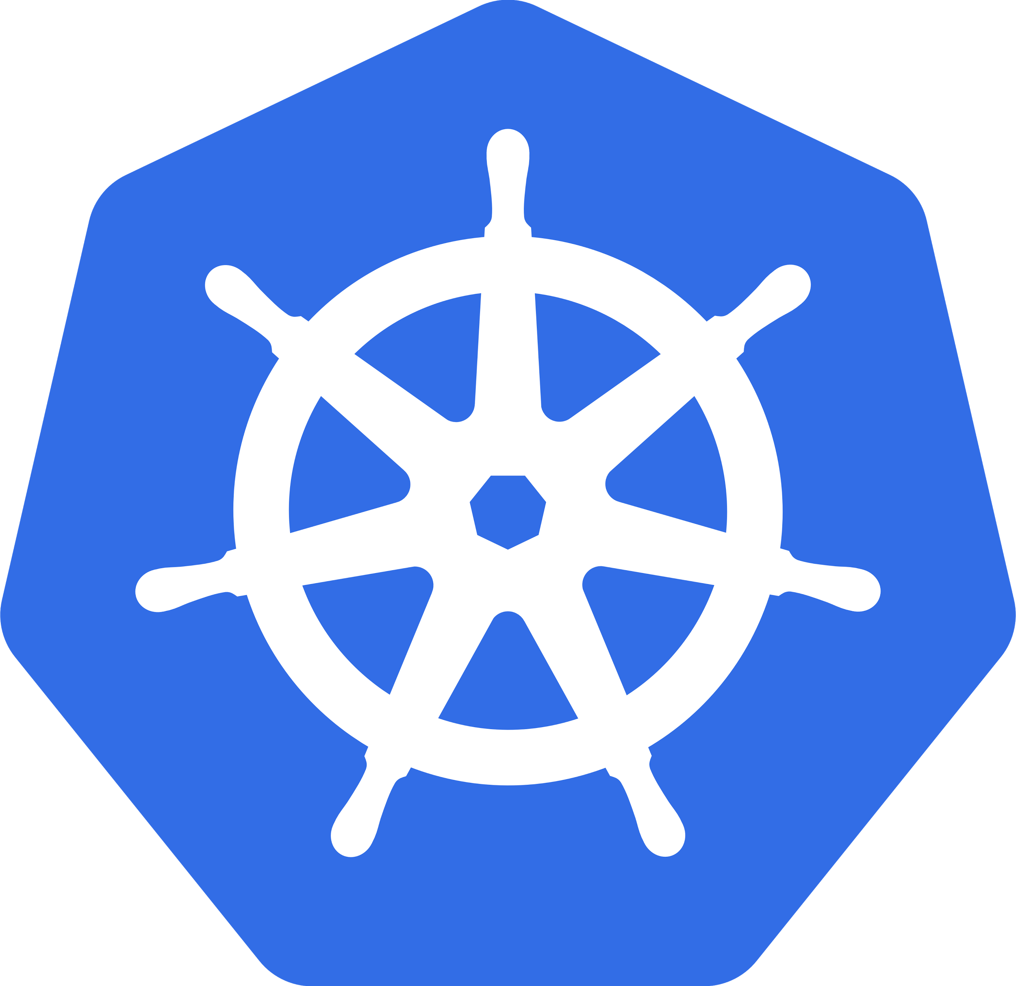
Open Source Containers: Kubernetes
Greek for “Helmsman”; also the root of the word “Governor” and “cybernetic”
Container orchestrator
Builds on Docker containers
also supporting other container technologies
Multiple cloud and bare-metal environments
Supports existing OSS apps
Does not require apps becoming cloud-native
Inspired and informed by Google’s experiences and internal systems
100% Open source, written in Go
Let users manage applications, not machines
http://kubernetes.io/docs/whatisk8s/

Slide 23
What is Kubernetes & why ?
We need more than just packing and isolation
What is Kubernetes
Scheduling: Where should my containers run?
Lifecycle and health: Keep my containers running despite failures, upgrade/rollback
Discovery: Where are my containers now?
Isolation: keep my jobs from interfering with each other
Auth{n,z}: Control who can do things to my containers
Aggregates: Compose sets of containers into jobs
Scaling: Making jobs and cluster bigger or smaller
Security: Continuously scan container images for security vulnerabilities.
Provenance: How do I know that the software I’ve downloaded or been given really comes from a trusted party.
Load balancing: Distribute traffic across a set of containers
Provisioning Storage: Provide data to containers
Logging and monitoring: Track what’s happening with my containers
Debugging, introspection, late-binding configuration: Enter or attach to containers
Datacenter-scale operating system
Reduces: overhead, attack surface, complexity, infrastructure spend
Improves: code deployment time, flexibility, Ops efficiency, portability, fault tolerance
Declarative deployment model lets you “set and forget” infrastructure and app state

Slide 24
NextGen Principles : IT as a Service Provider
Containers isolates and package application workloads more efficiently than virtual machines.
Typical Infrastructure Using Server Virtualization
Ideal Infrastructure Using Application Containers
Application + dependencies
Application + dependencies
Application + dependencies
Application + dependencies
Application + dependencies
Application + dependencies
Application
Development maintenance and configuration responsibility
Application + dependencies
Application
Application
Application
Application
Application
Application
Container Engine
Host Operating System
Virtual Machine OS + dependencies
Virtual Machine OS + dependencies
Virtual Machine OS + dependencies
Virtual Machine OS + dependencies
Virtual Machine OS + dependencies
Virtual Machine OS + dependencies
Virtual Machine OS + dependencies
Infrastructure/Ops maintenance and configuration responsibility.
Hardware Layer
Hypervisor
Infrastructure/Ops can focus on reliability/availability/performance of the underlying server. Development can focus on the run-time and dependencies of the application.
Overlap where both development and operation have accountabilities
Hardware Layer

Slide 25
NextGen Principles : Clean Separation Concerns
Containers establish a clearer line of responsibility for application and infrastructure maintenance.
This change in process creates a transparent structure of responsibility from application development through application use. Development and operations are no longer conflicting on who is responsible for maintaining, updating, and monitoring applications and application dependencies.
Development is responsible for:
Maintaining applications and their dependencies, even after they’ve transitioned outside development and testing. Development will be responsible for everything inside the container. They will need to update and configure application libraries and dependencies, and insure that containers will function appropriately.
Operations is responsible for:
Maintaining the physical and virtual infrastructure that is used to host the containers. Infrastructure is responsible for everything outside the container. This includes the host OS, any VM instances, and VM guest OSs. Infrastructure must be able to guarantee, similar to PaaS, that containers will perform to the required organizational standards.
Previous roles and responsibilities
Development
Operations
Applications, libraries, and dependencies
Physical and virtual environment maintenance
Roles and responsibilities with containers
Development
Operations
Inside the container
Outside the container

Slide 26
ISVs Are Targeting Containers
Software Ford buys has begun to be shipped as containers.
- For example Oracle, SQL Server 2017, Magneto, MongoDB, Redis
Application
Libraries
Dependencies
Containers are more than just a tool for application developers
Packaging software with dependencies makes sense for software vendors
Independent software vendors have identified advantages in solutions delivery through containers.
Software compatibility is a significant issue in getting software to work the way it was meant to.
Applications benefit largely from containerization, because they are packaged with all of the required dependencies. Delivering software inside containers will simplify the instantiation and use of software in the enterprise.
capabilities.
Packaged Software Containers
Next-Gen Container as a Service (CaaS) will provide a hosting environment for this new demand and improve our infrastructure capabilities.
CaaS is our primary solution for hosting COTS and enables evergreen infrastructure while enabling separation of concerns between application/service owners and infrastructure owner/operators.

Slide 27
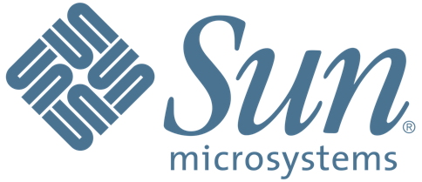

Non-Virtualized Servers: Sun (2000)
Launching a new application? Buy a new server; or a rack of them!
Building block of your application is physical servers
Non- Virtualized
Hardware
2000

Slide 28
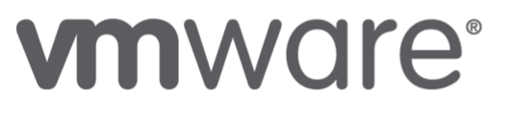

Virtualization: VMWare (2001)
Releases for server market in 2001
Popularizes virtual machines (VMs)
Run many VMs on one physical machine, meaning you can buy fewer servers!
Architectural building block becomes a VM
Non- Virtualized
Hardware
Virtualiza- tion
2000
2001

Slide 29
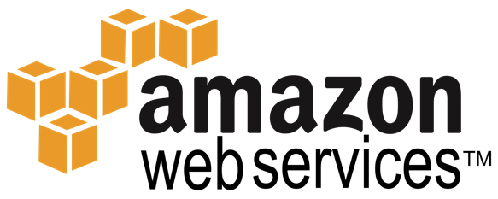

IaaS: AWS (2006)
Amazon Web Services (AWS) creates the Infrastructure-as-a-Service market by launching Elastic Compute Cloud (EC2) in 2006
Rent servers by the hour
Convert CapEx to OpEx
Architectural building block is also a VM, called an Amazon Machine Image (AMI)
Non- Virtualized
Hardware
Virtualiza- tion
IaaS
2000
2001
2006

Slide 30
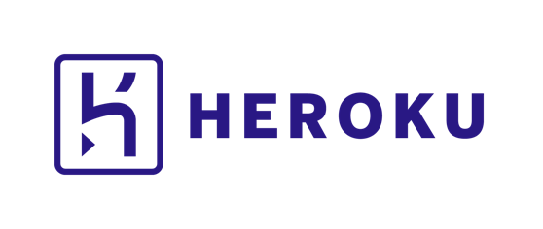

PaaS: Heroku (2009)
Heroku popularizes Platform-as-a-Service (PaaS) with their launch in 2009
Building block is a buildpack, which enables containerized 12-factor applications
The process for building the container is opaque, but:
Deploying new version of an app is just: git push heroku
Non- Virtualized
Hardware
Virtualiza- tion
IaaS
PaaS
2000
2001
2006
2009

Slide 31
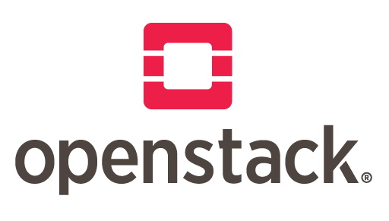
Open Source IaaS: OpenStack (2010)
OpenStack brings together an extraordinarily diverse group of vendors to create an open source Infrastructure-as-a-Service (IaaS)
Competes with AWS and VMWare
Building block remains a VM
Non- Virtualized
Hardware
Open Source
IaaS
Virtualiza- tion
IaaS
PaaS
2000
2001
2006
2009
2010

Slide 32
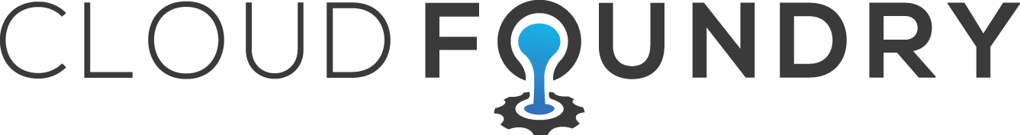

Open Source PaaS: Cloud Foundry (2011)
Pivotal builds an open source alternative to Heroku’s PaaS and launches the Cloud Foundry Foundation in late 2014
Building block is Garden containers, which can hold Heroku buildpacks, and even non-Linux OSes
Non- Virtualized
Hardware
Open Source
IaaS
Open Source
PaaS
Virtualiza- tion
IaaS
PaaS
2000
2001
2006
2009
2010
2011

Slide 33
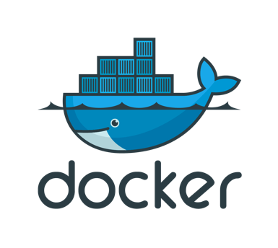

Containers: Docker (2013)
Docker combines LXC, Union File System and cgroups to create a containerization standard adopted by millions of developers around the world
Fastest uptake of a developer technology ever
Enables isolation, reuse and immutability
Non- Virtualized
Hardware
Open Source
IaaS
Open Source
PaaS
Virtualiza- tion
IaaS
PaaS
Containers
2000
2001
2006
2009
2010
2011
2013
Notes:
Now being standardized in the Open Container Initiative

Slide 34

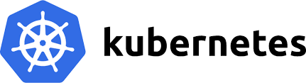
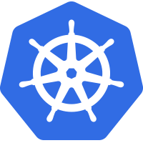
Cloud Native: CNCF (2015)
Cloud native computing uses an open source software stack to:
segment applications into microservices,
packaging each part into its own container
and dynamically orchestrating those containers to optimize resource utilization
Non- Virtualized
Hardware
Open Source
IaaS
Open Source
PaaS
Cloud Native
Virtualiza- tion
IaaS
PaaS
Containers
2000
2001
2006
2009
2010
2011
2013
2015

Slide 35
What Have We Learned?
Core Building Block:
Servers ➡ Virtual Machines ➡ Buildpacks ➡ Containers
Isolation Units
From heavier to lighter weight, in spin-up time and size
Immutability
From pets to cattle
Provider
From closed source, single vendor to open source, cross-vendor

Slide 36
Iaas, CaaS, PaaS
Feature | Infrastructure-as-a-Service (Vmware) | Container-as-a-Service (Kubernetes) | Platform-as-a-Service (PCF)
Scheduling | DRS | Scheduler | Diego
Management | vCenter | Controller | Diego (AI) & BOSH (VMs & Services)
Scheduling unit | Virtual Machine | Pods (one or more containers) | Garden containers
Orchestration | VRA / VRO | API Server | Diego & BOSH
Configuration Management | Chef, Puppet, Ansible | Secrets, ConfigMaps, Lifecycle hooks, Init containers | BOSH (only for VMs)
Health Checks | vCenter, vmtools probes | Liveness and Readness Probes (HTTP/TCP/CMD) | BOSH Resurrector (only for VMs), BBS (for application containers)
Target Workloads | Virtual Machine | Virtual Machine, Monolith Applications, 12-factor micro-services | 12-factor micro services
Persistent Storage | VSAN, NFS, iSCSI | VSAN, NFS, iSCSI, RBD, cloud storage (AWS, Azure, GCP) | Volume Services under development
Platform support | Physical, Cloud | Physical, Virtual, and Cloud | Virtual and Cloud
Resources Management | CPU, Memory, Disk, Network | CPU, GPU, Memory, Network, Disk (Quotas) and fine grained container resource mgmt | Only Disk and Memory via quotas
Affinity & Anti-affinity | vCenter | Native Feature | NONE
Taints & Tolerations |  | Native Feature | NONE
Notes:
http://blog.kubernetes.io/2017/03/advanced-scheduling-in-kubernetes.html

Slide 37
Iaas, CaaS, PaaS
Feature | Infrastructure-as-a-Service (Vmware) | Container-as-a-Service (Kubernetes) | Platform-as-a-Service (PCF)
High Availability | Vmware HA Cluster | ReplicaSets, StatefulSets | Multiple AIs
Disaster Recovery | SRM | Self Hosting (Bootkube), Operators (TRPs) | NONE
Service Discovery | NONE | Service, DNS | NONE
Load Balancing | NSX (NFV), | Service (iptables, IPVS) | GO Router
Federation |  | Federation API | NONE
Self Healing | Vmware HA Cluster | Controller, Scheduler | BOSH Resurrector (only for VMs), BBS (for application containers)
Zero Downtime Upgrades | vMotion | Self Hosting (Bootkube) | Partial Support
Networking | Virtual Networking | Overlay, L2, Routed (L3) | NAT
Auto Scaling/Idling | VRA, VRO, VROPS | Pod Horizontal/Vertical Auto scaler (CPU, Memory, Custom Metrics). Cluster Auto Scaler. | AI (Container Auto Scaler – CPU only)
Network Security | NSX, Cisco ACI | Network Security Policy, Cisco ACI. All cluster components secured using TLS. Application TLS terminated at containers. | Foundation components are not secured. ASGs provide means to define egress policies. Application TLS terminated at “Go Routers”

Slide 38

Avoid Vendor Lock-in
Open source software stack enables deployment on any public, private cloud or hybrid cloud

Slide 39
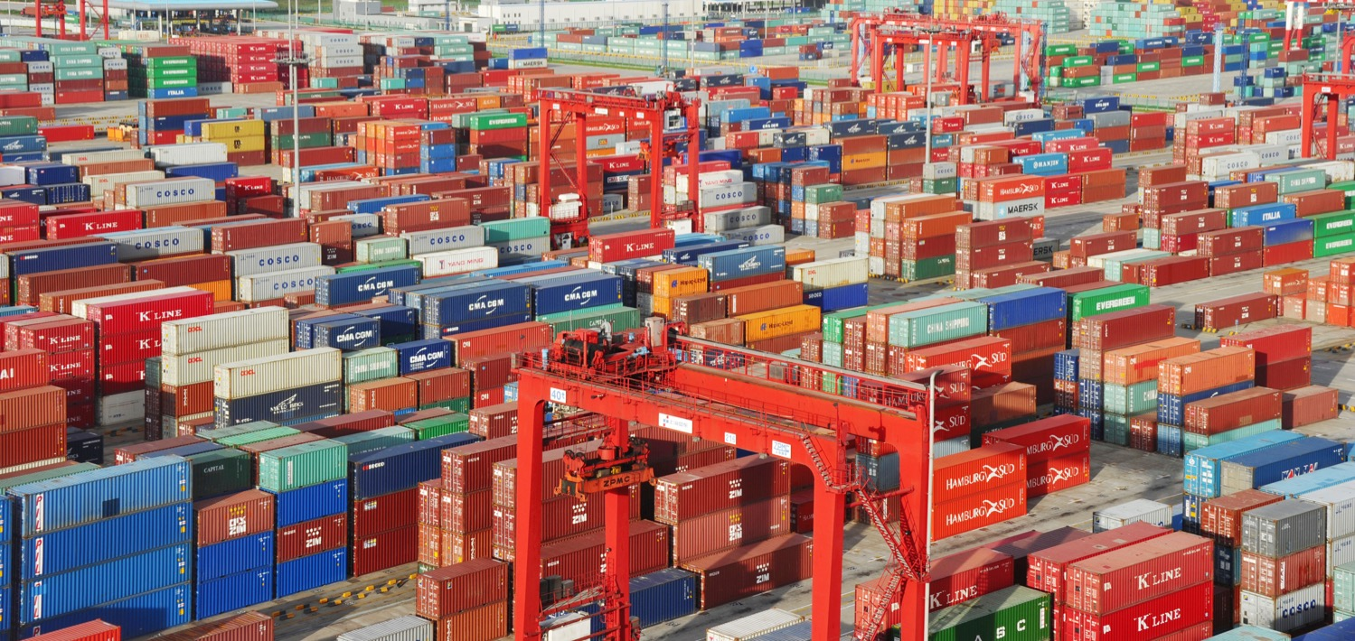
Enable Unlimited Scalability
Scales from several nodes on your laptop to tens of thousands of self-healing multi-tenant nodes
Notes:
For example, Google starts 2 billion containers per week
2 billion containers a week is 3300 a second, and that statistic was from 2014

Slide 40
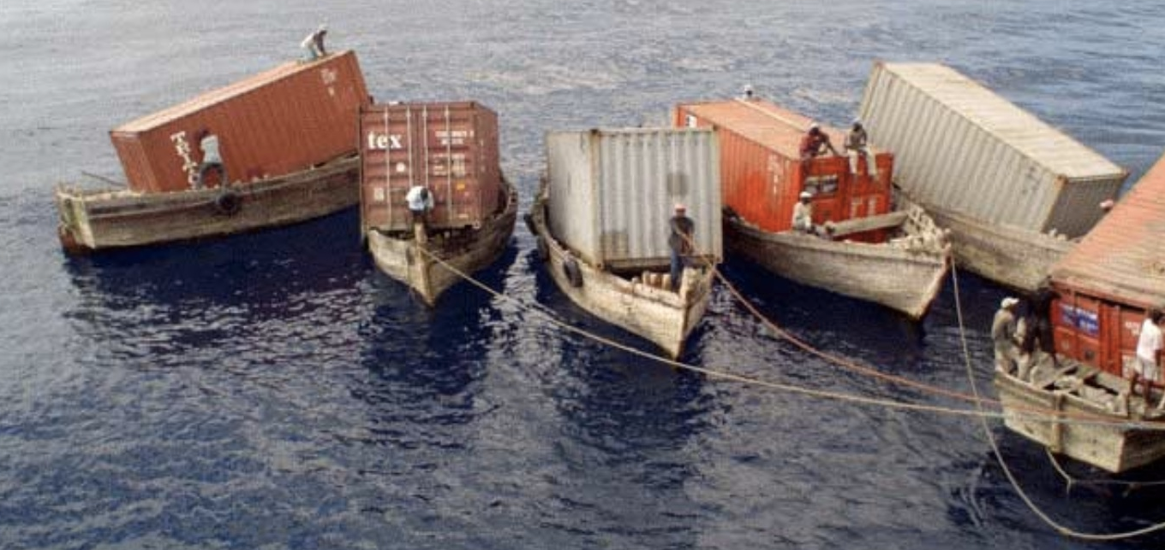
Increase Agility and Maintainability
By splitting applications into microservices with explicitly described dependencies

Slide 41
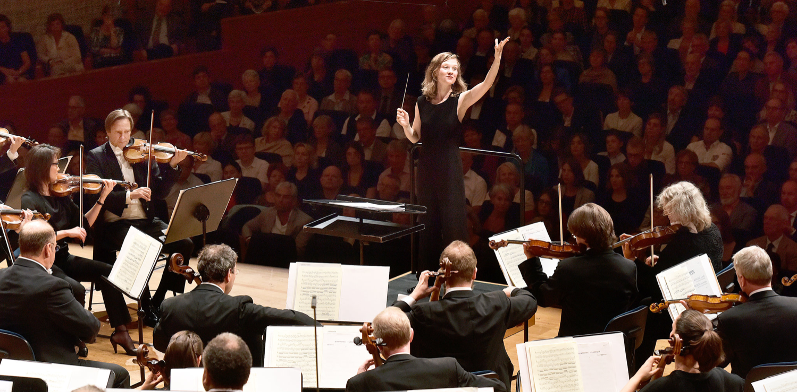
Improve Efficiency and Resource Utilization
Via a central orchestrating process that dynamically manages and schedules microservices
Notes:
This reduces the costs associated with maintenance and operations

Slide 42
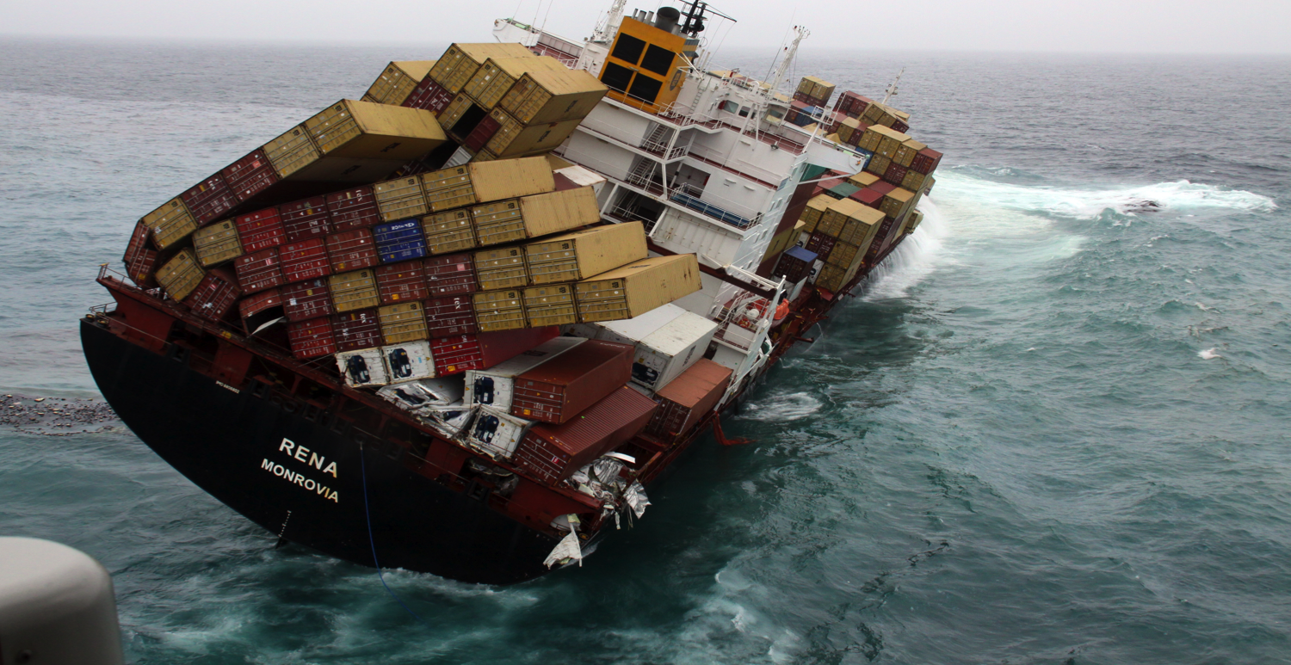
Achieve Resiliency
To failures of individual containers, machines, and even data centers and to varying levels of demand

Slide 43
Cloud Native Enables High Performance
High-performing teams deploy more frequently and have much faster lead times.
They make changes with fewer failures, and recover faster from failures.
2,555x
3x
200x
24x
200x more frequent deployments
2,555x shorter lead times
3x lower change failure rate
24x faster recovery from failures
2016 State of DevOps Report Infographic from Puppet

Slide 44

Greenfield Applications
Cloud Native application architectures are the default choice for greenfield applications

Slide 45
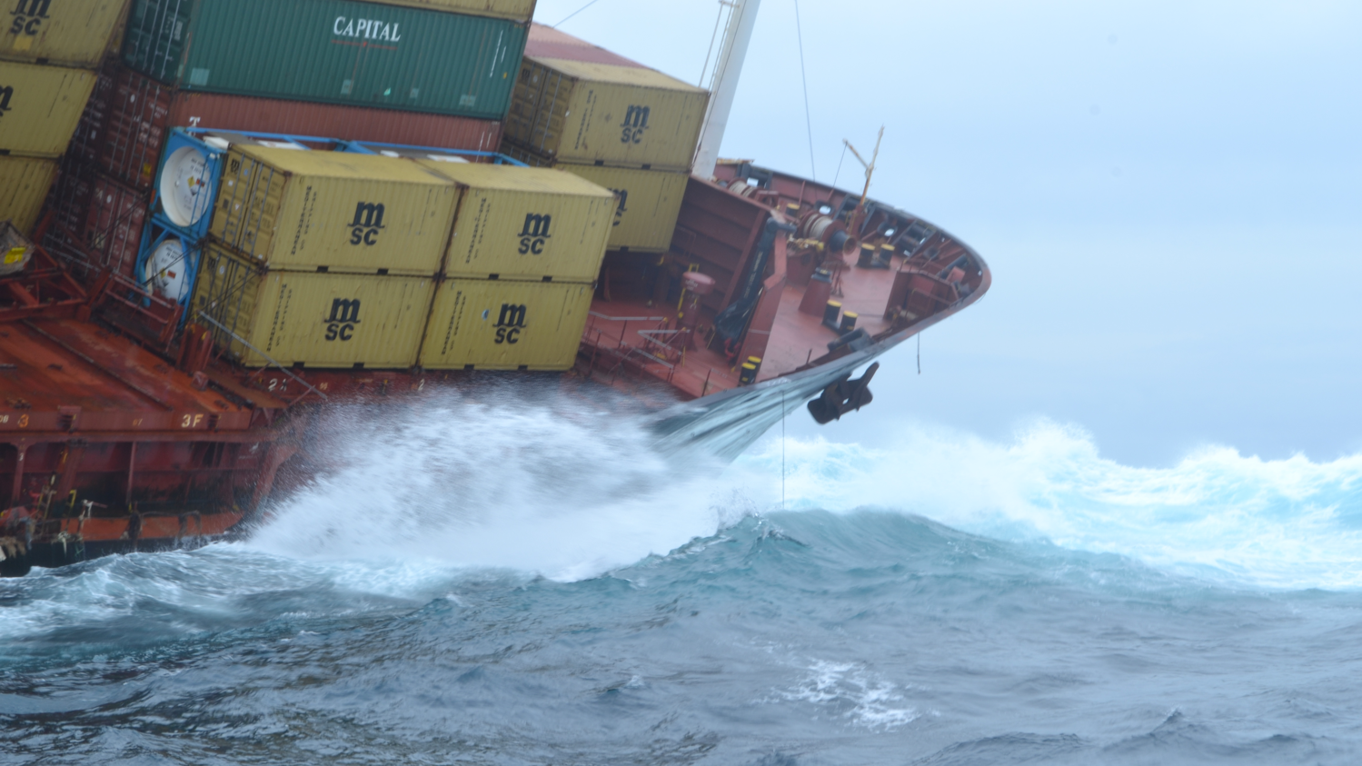
In the long run we are all dead. Economists set themselves too easy, too useless a task, if in tempestuous seasons they can only tell us, that when the storm is long past, the ocean is flat again.
– John Maynard Keynes

Slide 46
…too easy, too useless a task…

Slide 47

The Real World Consists of Brownfield Applications
The gross world product is about $100 trillion and almost all of it flows through brownfield applications, which are generally monoliths

Slide 48
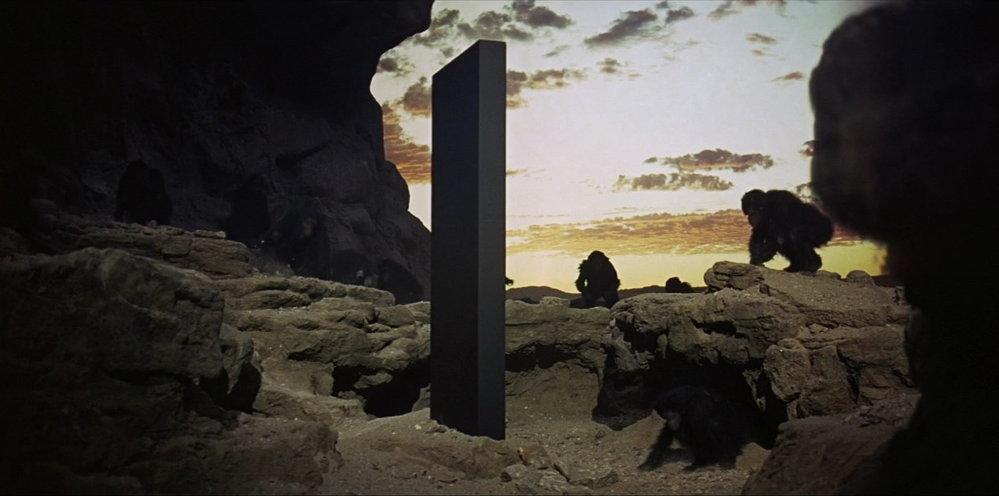
Nearly All Production Applications Are Monoliths
Notes:
Cloud native hasn’t been around that long, so most production applications are large, integrated units, not containerized microservices. How do we get from monoliths to microservices?

Slide 49
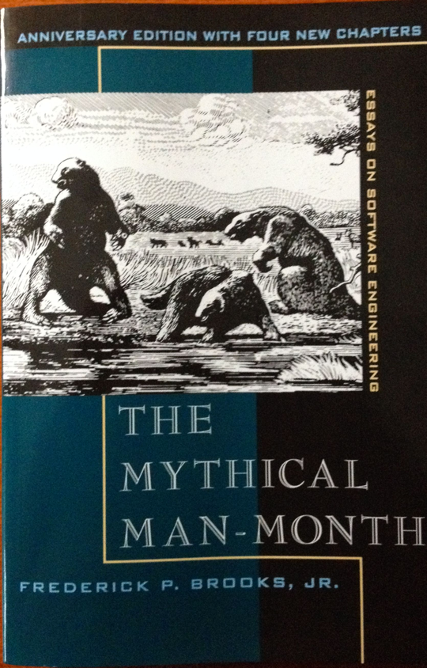
How About a Rewrite?
The Second System Syndrome says that many rewrites end in failure
The existing system evolves faster than the second one can catch up
Notes:
The Second System Effect was defined in the Mythical Man Month.

Slide 50
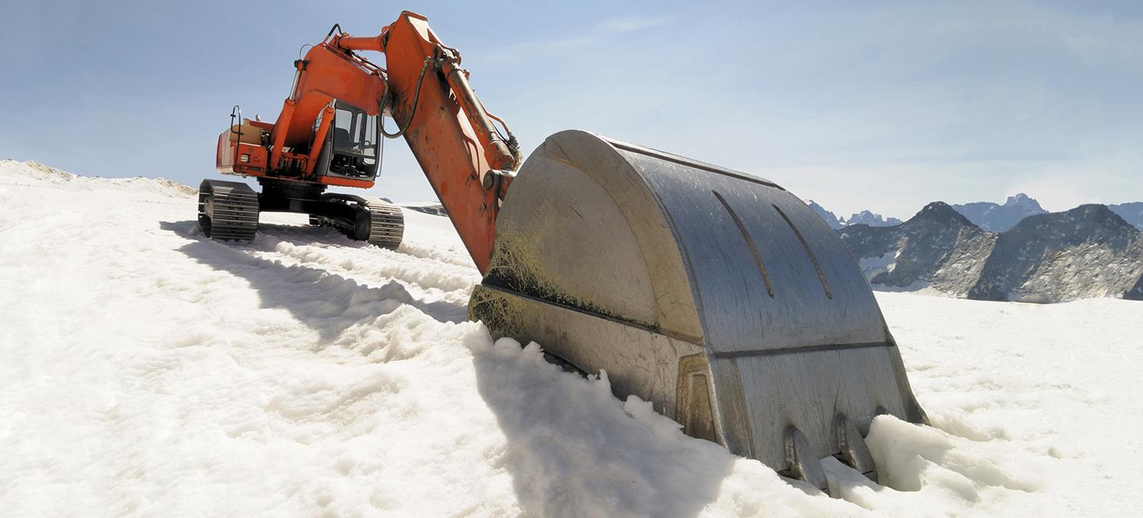
Step One Is to Stop Digging
Notes:
If you keep doing software development the way you’ve always done, you’re going to be too slow to compete.

Slide 51
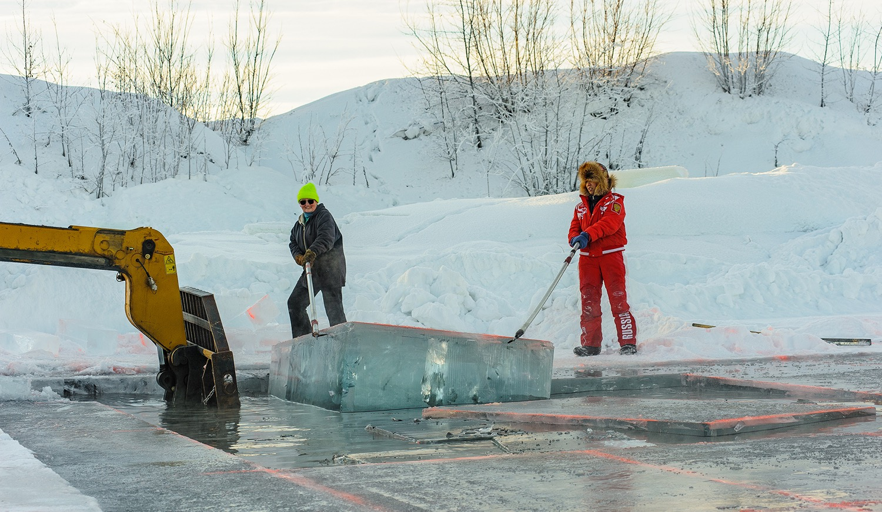
Step Two is Lift-and-Shift Your Monolith
StatefulSets are helpful for providing stable, persistent storage and unique network identifiers to your monolith
Notes:
This means wrapping your monolith in a container, even if it’s an 8 GB Java virtual machine or emulated mainframe code. TicketMaster ported their PDP-11 minicomputer code to run on an emulator in a container. The container is hopefully generated by your CI/CD system and can now live in the cloud or on your bare metal cluster. StatefulSets have been available since Kubernetes 1.5 (and were previously called PetSets).

Slide 52

Chip Away at the Monolith
As different parts of your monolith need upgrades or improvements, consider chipping away at that functionality and moving it to its own microservice
Notes:
For example, Ticketmaster has a situation where almost every concert announcement is like a DDoS attack. Containerization and running on Kubernetes lets them both autoscale and add resiliency
But, depending on the size of the challenge, maybe you will need a chainsaw.

Slide 53

New Functionality Can Go in New Apps
Write new functionality in separate applications optimized for it, such as Node.js for OAuth or Go for performance sensitive tasks
Notes:
KeyBank put in Node.js application servers to support mobile in front of their monolithic Java application.

Slide 54

Start with Stateless Services
Kubernetes delivers the largest immediate value today for stateless services, such as application front end servers that need resiliency, load-balancing, autoscaling, etc.
Notes:
For example, Wikipedia is moving their Mediawiki application servers but is leaving their MySQL running on bare metal for now. If you’re on the public cloud, consider hosted data stores.

Slide 55

Transition Your Data Stores Last
Supporting stateful services like Postgres or Redis remains the most challenging part of working with Kubernetes and should likely go last in any transition
Notes:
GitHub succeeded in transferring all of their stateless servers on to Kubernetes, and is now digging in to deploy stateful solutions.

Slide 56
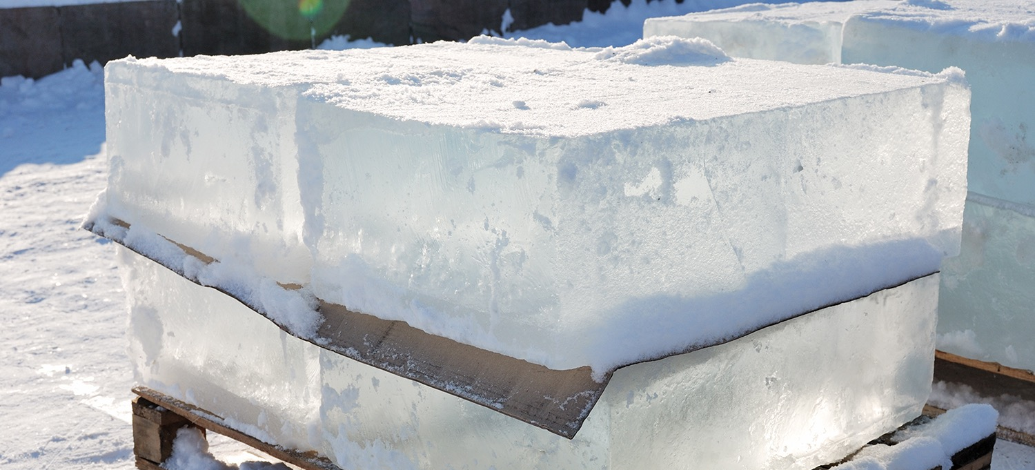
Monoliths Are the Antithesis of Cloud Native
Inflexible, tightly-coupled, brittle
Notes:
So, what do we do?

Slide 57
Kubernetes and Greenfield
Avoid the “soft bigotry of low expectations” of thinking that you need to do a greenfield rewrite to get the benefits of cloud native
Notes:
But Kubernetes is certainly a great solution for greenfield app development.

Slide 58

Kubernetes and Brownfield
brownfield applications

Slide 59
Ford’s Kubernetes Use Cases
Provide resilient API driven hosting infrastructure for:
Stateful data service (MongoDB, Redis, PostgreSQL)
Commercial off-the-shelf (COTS) applications (IBM MQ, Gradle Enterprise)
Analytics, Machine Learning, and Artificial intelligence

Slide 60
More Info on Evolving Monoliths
Box
https://architecht.io/box-co-founder-on-moving-to-microservices-and-the-promise-of-kubernetes-a49f01b1c0c0
Key Bank
https://developers.redhat.com/blog/2016/10/27/the-fast-moving-monolith-how-we-sped-up-delivery-from-every-three-months-to-every-week/
TicketMaster
https://www.linux.com/news/learn/kubernetes/ticketmaster-chooses-kubernetes-stay-ahead-competition
Wikipedia
https://kubernetes.io/case-studies/wikimedia/
GitHub
https://githubengineering.com/kubernetes-at-github/

Slide 61
Appendix

Slide 62
Kubernetes Training Resources
Kubernetes Bootcamp
Kubernetes Webinar Series
Webinar Series: Deploying & Managing Containerized Workloads in the Cloud
Introduction to Kubernetes
Introduction to Cloud Infrastructure Technologies
Scalable Microservices with Kubernetes
Fundamentals of Containers, Kubernetes

